Slide 1

How to write a Research Paper?
By
Maitreyee Dutta
Assistant Professor
Khagarijan College, Nagaon, Assam

Slide 2
Overview
What is Academic Writing
Important Aspects of Academic Writing
Demystifying the Myths of Academic Writing
Types of Academic Writing
Levels of Critical Writing- Bloom’s Taxonomy
What is a Seminar?
Key Features of a Seminar
How to write a Seminar Paper?
Publication Ethics

Slide 3

What is Academic Writing?
Academic writing is a style of writing that is commonly used in educational settings and scholarly communication. It is characterized by its formal, structured, and objective approach to presenting information and arguments.

Slide 4

Important Aspects of Academic Writing
Critical Thinking
Clarity and Precision
Objectivity
Citations and References
Structured Format
Formal Tone
Audience
Revision and Proofreading

Slide 5
Critical Thinking
Academic writers are expected to evaluate and analyze existing research, theories, and evidence to form their own arguments and contribute to their field of study.
Clarity and Precision
It aims to convey ideas and information clearly and precisely. It avoids ambiguity and uses formal language to ensure that the message is effectively communicated.
Objectivity
It is typically objective and impersonal. It avoids personal opinions, emotions, and bias, relying on evidence and rational arguments.

Slide 6
Citations and References
Proper citation of sources is a fundamental aspect of academic writing. Writers are required to acknowledge the work of others and provide references for the sources they use, following a specific citation style (e.g., APA, MLA, Chicago).
Structured Format
Academic writing often follows a structured format, including an introduction, literature review, methodology (in research papers), main body, analysis, conclusion, and references or bibliography. This structure helps readers navigate the content.
Formal Tone
It maintains a formal and scholarly tone. Slang, colloquial language, and contractions are typically avoided.

Slide 7
Audience
Academic writing is usually intended for an educated and specialized audience, such as professors, researchers, or fellow students. As such, it assumes a certain level of prior knowledge in the field.
Revision and Proofreading
Academic writing requires careful revision and proofreading to ensure accuracy and adherence to style and formatting guidelines.
EXAMPLES OF ACADEMIC WRITING: Common types of academic writing include research papers, essays, literature reviews, theses, dissertations, conference papers, and scholarly articles. The style and conventions may vary slightly depending on the discipline and the specific academic context.

Slide 8
Abstract in a Research Paper
It is an original work, not an excerpted passage. An abstract must be fully self-contained and make sense by itself, without further reference to outside sources or to the actual paper. It highlights key content areas, your research purpose, the relevance or importance of your work, and the main outcomes.
It is a well-developed single paragraph of approximately 250 words in length, which is indented and single spaced. The function of the abstract is to outline briefly all parts of the paper. Although it is placed at the beginning of your paper, immediately following the title page, the abstract should be the last thing that you write, once you are sure of the conclusions you will reach.
Types of Abstracts
Abstracts can be informative and descriptive.
Descriptive abstracts - describe the work being abstracted. They are more like an outline of the work and are usually very short - 100 words or less.
Informative abstracts - act as substitutes for the actual papers as all the key arguments and conclusions are presented; specifically, the context and importance of the research, reasons for methods, principal results and conclusions.

Slide 9
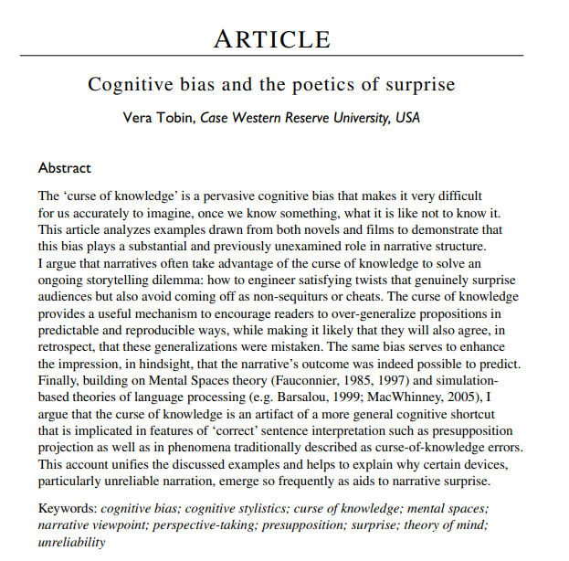
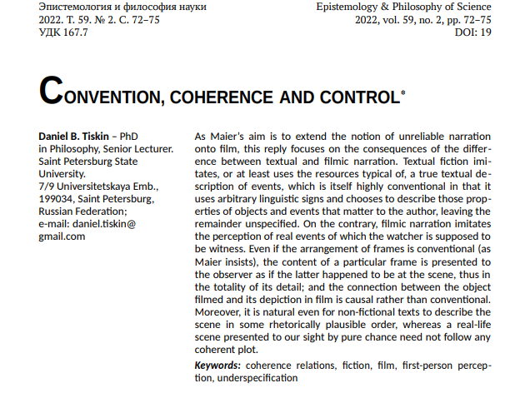

Slide 10
What is Hypothesis in Research Paper?
A research hypothesis is a statement of expectation or prediction that will be tested by research. A hypothesis is not just a guess – it should be based on existing theories and knowledge. It also has to be testable, which means you can support or refute it through scientific research methods (such as experiments, observations and statistical analysis of data).
Step 1: Ask a question – Writing a hypothesis begins with a research question that you want to answer. The question should be focused, specific, and researchable within the constraints of your project.
Step 2: Do some preliminary research –Your initial answer to the question should be based on what is already known about the topic. Look for theories and previous studies to help you form educated assumptions about what your research will find. At this stage, you might construct a conceptual framework to ensure that you’re embarking on a relevant topic. This can also help you identify which variables you will study and what you think the relationships are between them. Sometimes, you’ll have to operationalize more complex constructs.
Step 3: Formulate your hypothesis – Now you should have some idea of what you expect to find. Write your initial answer to the question in a clear, concise sentence.

Slide 11



Slide 12

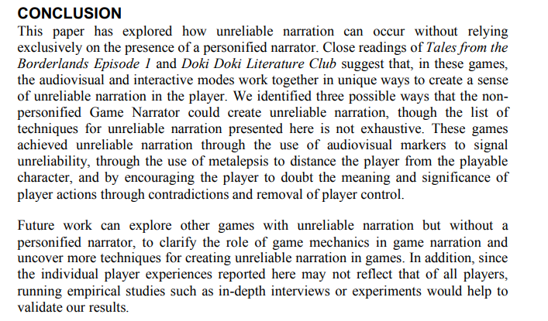

Slide 13




Challenges
Lack of awareness
Myths
Academic Writing for a young researcher has various challenges. Of it the three prominent ones are:
Lack of awareness regarding approaching/selecting/researching a topic.
Lack of patience while formulating/writing a paper.
Falling prey to myths of Academic Writing
Challenges
Lack of patience

Slide 14
Some Myths of Academic Writing
1) The “Paint by Numbers” Myth
2) Writers only start writing when they have everything figured out
3) Perfect First Drafts
4) The Genius Fallacy

Slide 15
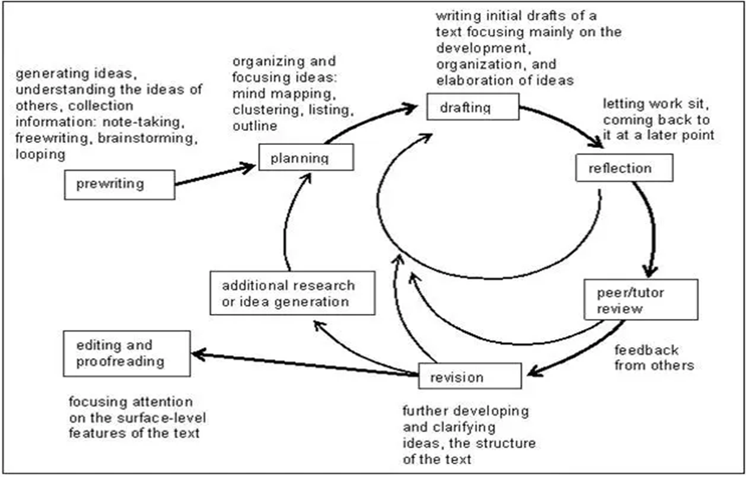
The “Paint by Numbers” Myth
Some writers believe that certain steps must be performed in a specific order to write “correctly”. It is in fact not a lock step linear process but is instead a recursive one.

Slide 16

Writers only start writing when they have everything
No writer has everything in hand before writing. It is a wrong concept. In fact improvisation is the key and one needs to pen down whatever they feel is necessary and can revisit it as many times as necessary.
Perfect First Drafts
Nothing is the best on the first try itself. Same is the case with academic papers. So there is no use putting unrealistic expectations on the first draft of your paper expecting it to be your shining jewel.
In fact it takes a lot of revisions to gain an identity.

Slide 17
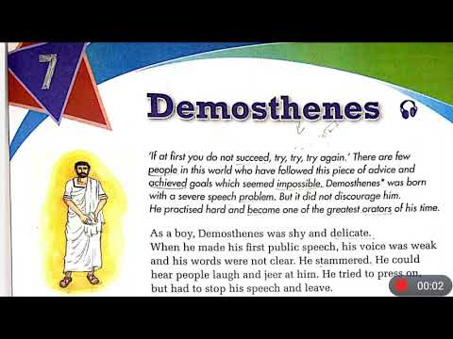
The Genius Fallacy
Writing ability is not a fixed genetic code. It is not so that one can simply decide that they are not a genius and hence cannot write a good paper. This conception is absolutely ridiculous because everyone can improve and better themselves with practice and effort.

Slide 18
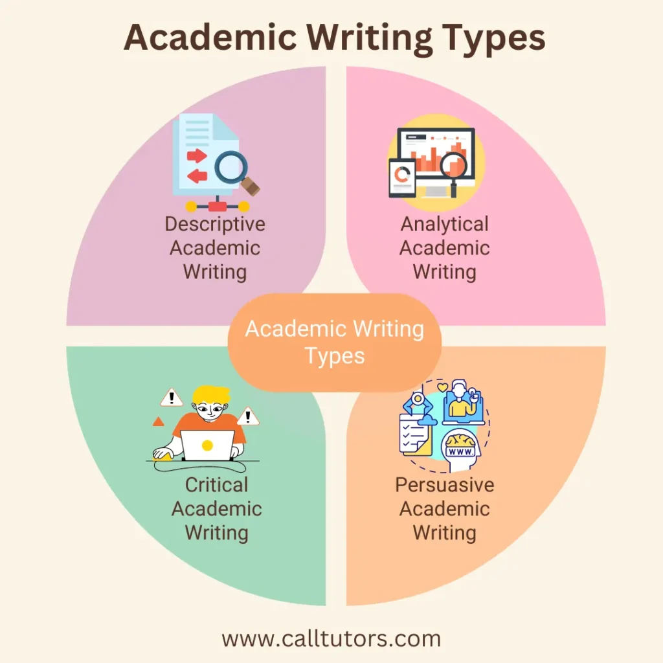
Types of Academic Writing

Slide 19
Descriptive: To provide facts or information. The kinds of instructions for a purely descriptive assignment include: 'identify', 'report', 'record', 'summarise' and 'define’. Example - summary of an article or a report of the results of an experiment.
Analytical: Requires you to re-organise the facts and information you describe into categories, groups, parts, types or relationships. The kinds of instructions for an analytical assignment include: 'analyse', 'compare', 'contrast', 'relate', and 'examine’.
Persuasive: Has all the features of analytical writing (that is, information plus re-organising the information), with the addition of your own point of view. Can include an argument, recommendation, interpretation of findings or evaluation of the work of others. The kinds of instructions for a persuasive assignment include: 'argue', 'evaluate', 'discuss', and 'take a position’.
Critical : It requires you to consider at least two points of view, including your own or multiple viewpoints. The kinds of instructions for critical writing include: 'critique', 'debate', 'disagree' and 'evaluate’. Example - Critique of a journal article, or a literature review that identifies the strengths and weaknesses of existing research.

Slide 20
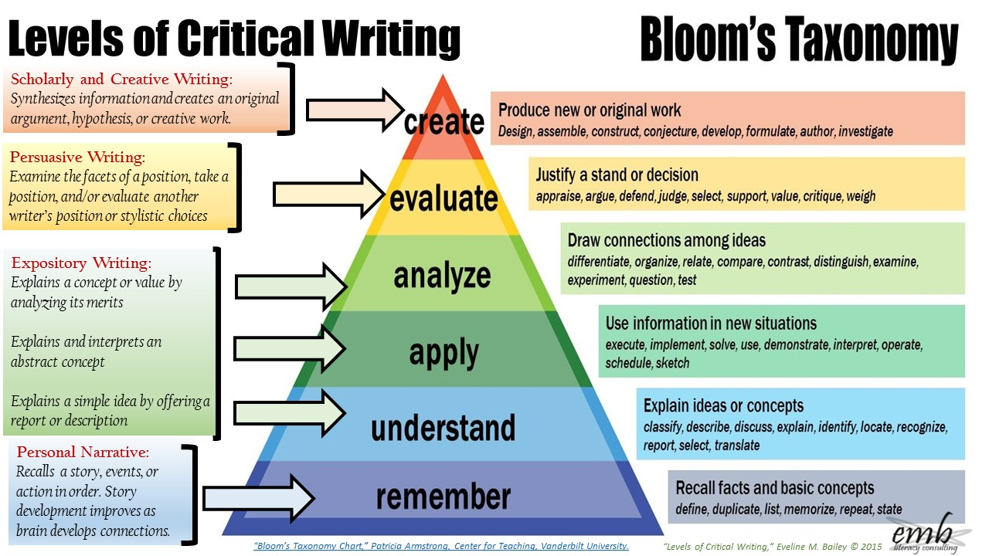
Bloom’s Taxonomy

Slide 21

What is a Seminar?
It is a structured academic or professional meeting where a group of individuals with common interests or expertise in a particular subject, gather to discuss, present, and exchange ideas, research findings, or information.
Seminars are often characterized by their interactive and participatory nature, as they encourage active engagement and discussion among participants.

Slide 22

Presentation: One or more speakers may present information, research, or a topic to the audience. These presentations are often followed by discussions or Q&A sessions.
Discussion: Seminars promote open discussions and debates among participants. Attendees are encouraged to ask questions, share their perspectives, and engage in critical thinking about the topic.
Small groups: Seminars are often conducted with a limited number of participants, allowing for more intimate and focused interactions.
Informality: Compared to traditional lectures, seminars tend to be less formal in structure. They emphasize collaborative learning and active participation.
Interdisciplinary: Seminars can cover a wide range of subjects and may bring together individuals from diverse backgrounds and fields of study or expertise.
Learning and professional development: Seminars serve as a platform for individuals to enhance their knowledge, share experiences, and network with others who share similar interests or goals.
.
Key Features of a Seminar

Slide 23
How to Write a Seminar Paper?
Select a Topic
Research
Create an Outline
Write an Introduction
Review of Literature
Methodology (If Applicable)
Main Body
Analysis
Conclusion
References
Proofread and Edit
Peer Review
Finalize and Submit
.

Slide 24
Topic Selection : Choose a topic that interests you and aligns with the objectives of the seminar. Ensure it is specific enough to explore in depth but not so narrow that you lack resources or information.
Research: Gather relevant sources of information such as books, academic journals, articles, and online resources. Take detailed notes and keep track of your sources for citations.
Create an Outline: Organize your thoughts and information into a clear outline. This will serve as the backbone of your paper and help you structure your arguments logically. Typically, an outline includes sections like introduction, literature review, methodology (if applicable), main body, analysis, conclusion, and references.

Slide 25
Write an Introduction: Start with a compelling introduction that provides background information on your topic and outlines the purpose and scope of your paper. Include a clear thesis statement that states your main argument or research question.
Review of Literature : Review existing literature related to your topic. Discuss the key theories, concepts, and studies relevant to your research. Analyze and synthesize the literature to identify gaps or areas where your research contributes.
Methodology (If Applicable): If your seminar paper involves empirical research, explain your research methods, data collection, and data analysis techniques. Be clear and transparent about how you conducted your research.
.

Slide 26
Main Body: Present your arguments, findings, and analysis in a structured manner. Use clear and concise language. Each paragraph should have a clear topic sentence. Provide evidence and examples to support your claims, citing your sources properly.
Analysis: Analyze your findings in the context of your research question or thesis statement. Discuss the implications of your findings and how they contribute to the broader understanding of the topic.
Conclusion: Summarize the main points of your paper. Restate your thesis and the significance of your research. Discuss any limitations and suggest directions for future research.
References: Create a bibliography or reference list that includes all the sources you cited in your paper. Follow the appropriate citation style (e.g., APA, MLA, Chicago).

Slide 27
Proofread and Edit: Carefully proofread your paper for grammar, spelling, and formatting errors. Ensure that your paper flows smoothly and that your arguments are well-structured.
Peer Review: Consider having someone else review your paper for feedback and suggestions.
Finalize and Submit: Make any necessary revisions based on feedback. Format your paper according to the seminar's guidelines and requirements. Submit your paper by the specified deadline. Adhere to the seminar's specific requirements, such as formatting, length, and citation style.

Slide 28
What are Publication Ethics?
Publication ethics in academic writing refer to the set of principles and standards that guide the conduct of researchers, authors, editors, and publishers in the process of producing and disseminating scholarly publications, including research papers, articles, books, and other academic works.
Adhering to publication ethics is essential to maintain the integrity, credibility, and trustworthiness of the academic publishing process.

Slide 29
Aspects of Publication Ethics
Authorship and Contributorship: All individuals who have made substantial contributions to the research should be listed as authors. Proper acknowledgements should be given to all contributors and honorary authorship should be avoided.
Plagiarism: Authors should ensure that their work is original and properly cited. Copying or closely paraphrasing the work of others without appropriate attribution is considered plagiarism and is unacceptable.
Data and Research Integrity: Researchers must accurately report their methods, results, and findings, even if they do not support the expected outcomes. Authors should be prepared to provide access to the data that underlies their research, and data should be retained for a reasonable period.

Slide 30
Ethical Research Practices:
Researchers should adhere to ethical guidelines and obtain necessary approvals for research involving human subjects, animals, or sensitive data. Informed consent must be obtained from participants in research studies, and their privacy and confidentiality should be protected.
Multiple or Duplicate Submissions: Submitting the same work to multiple journals simultaneously (multiple submissions) or publishing substantially the same work in more than one journal (duplicate publication) is considered unethical.
Corrections and Retractions: Authors have a responsibility to rectify the scientific record when necessary.
Transparency and Open Access: Authors should be transparent about their funding sources, affiliations, and potential conflicts of interest. Promoting open access and open science practices can enhance transparency and accessibility in research.
Homework

Slide 31

Homework

Slide 32


