Slide 1
WESTERN MYTHOLOGY
By
Maitreyee Dutta, Dept of English

Slide 2
INTRODUCTION TO GREEK MYTHOLOGY
Greek mythology, body of stories concerning the gods, heroes, and rituals of the ancient Greeks. That the myths contained a considerable element of fiction was recognized by the more critical Greeks, such as the philosopher Plato in the 5th–4th century BCE.
In general, however, in the popular piety of the Greeks, the myths were viewed as true accounts. Greek mythology has subsequently had extensive influence on the arts and literature of Western civilization, which fell heir to much of Greek culture.
The 5th-century-BCE Greek historian Herodotus remarked that Homer and Hesiod gave to the Olympian gods their familiar characteristics. Few today would accept this literally. In the first book of the Iliad, the son of Zeus and Leto (Apollo, line 9) is as instantly identifiable to the Greek reader by his patronymic as are the sons of Atreus (Agamemnon and Menelaus, line 16).
The fullest and most important source of myths about the origin of the gods is the Theogony of Hesiod (c. 700 BCE). The elaborate genealogies mentioned above are accompanied by folktales and etiological myths.
Fragmentary post-Homeric epics of varying date and authorship filled the gaps in the accounts of the Trojan War recorded in the Iliad and Odyssey; the so-called Homeric Hymns (shorter surviving poems) are the source of several important religious myths. Many of the lyric poets preserved various myths, but the odes of Pindar of Thebes (flourished 6th–5th century BCE) are particularly rich in myth and legend. The works of the three tragedians—Aeschylus, Sophocles, and Euripides, all of the 5th century BCE—are remarkable for the variety of the traditions they preserve.

Slide 3
Greek religious myths are concerned with gods or heroes in their more serious aspects or are connected with ritual. They include cosmogonical tales of the genesis of the gods and the world out of Chaos, the successions of divine rulers, and the internecine struggles that culminated in the supremacy of Zeus, the ruling god of Olympus (the mountain that was considered the home of the gods).
They also include the long tale of Zeus’s amours with goddesses and mortal women, which usually resulted in the births of younger deities and heroes. The goddess Athena’s unique status is implicit in the story of her motherless birth (she sprang full-grown from Zeus’s forehead); and the myths of Apollo explain that god’s sacral associations, describe his remarkable victories over monsters and giants, and stress his jealousy and the dangers inherent in immortal alliances
Myths of origin represent an attempt to render the universe comprehensible in human terms. Greek creation myths (cosmogonies) and views of the universe (cosmologies) were more systematic and specific than those of other ancient peoples.
Yet their very artistry serves as an impediment to interpretation, since the Greeks embellished the myths with folktale and fiction told for its own sake. Thus, though the aim of Hesiod’s Theogony is to describe the ascendancy of Zeus (and, incidentally, the rise of the other gods), the inclusion of such familiar themes as the hostility between the generations, the enigma of woman (Pandora), the exploits of the friendly trickster (Prometheus), and the struggles against powerful beings or monsters like the Titans (and, in later tradition, the Giants) enhances the interest of an epic account.
https://www.greekmythology.com/#:~:text=Greek%20Mythology%20is%20the%20set,and%20rituals%20of%20Ancient%20Greeks.&text=The%20most%20popular%20Greek%20Mythology,Athena%20and%20Titans%20like%20Atlas.

Slide 4
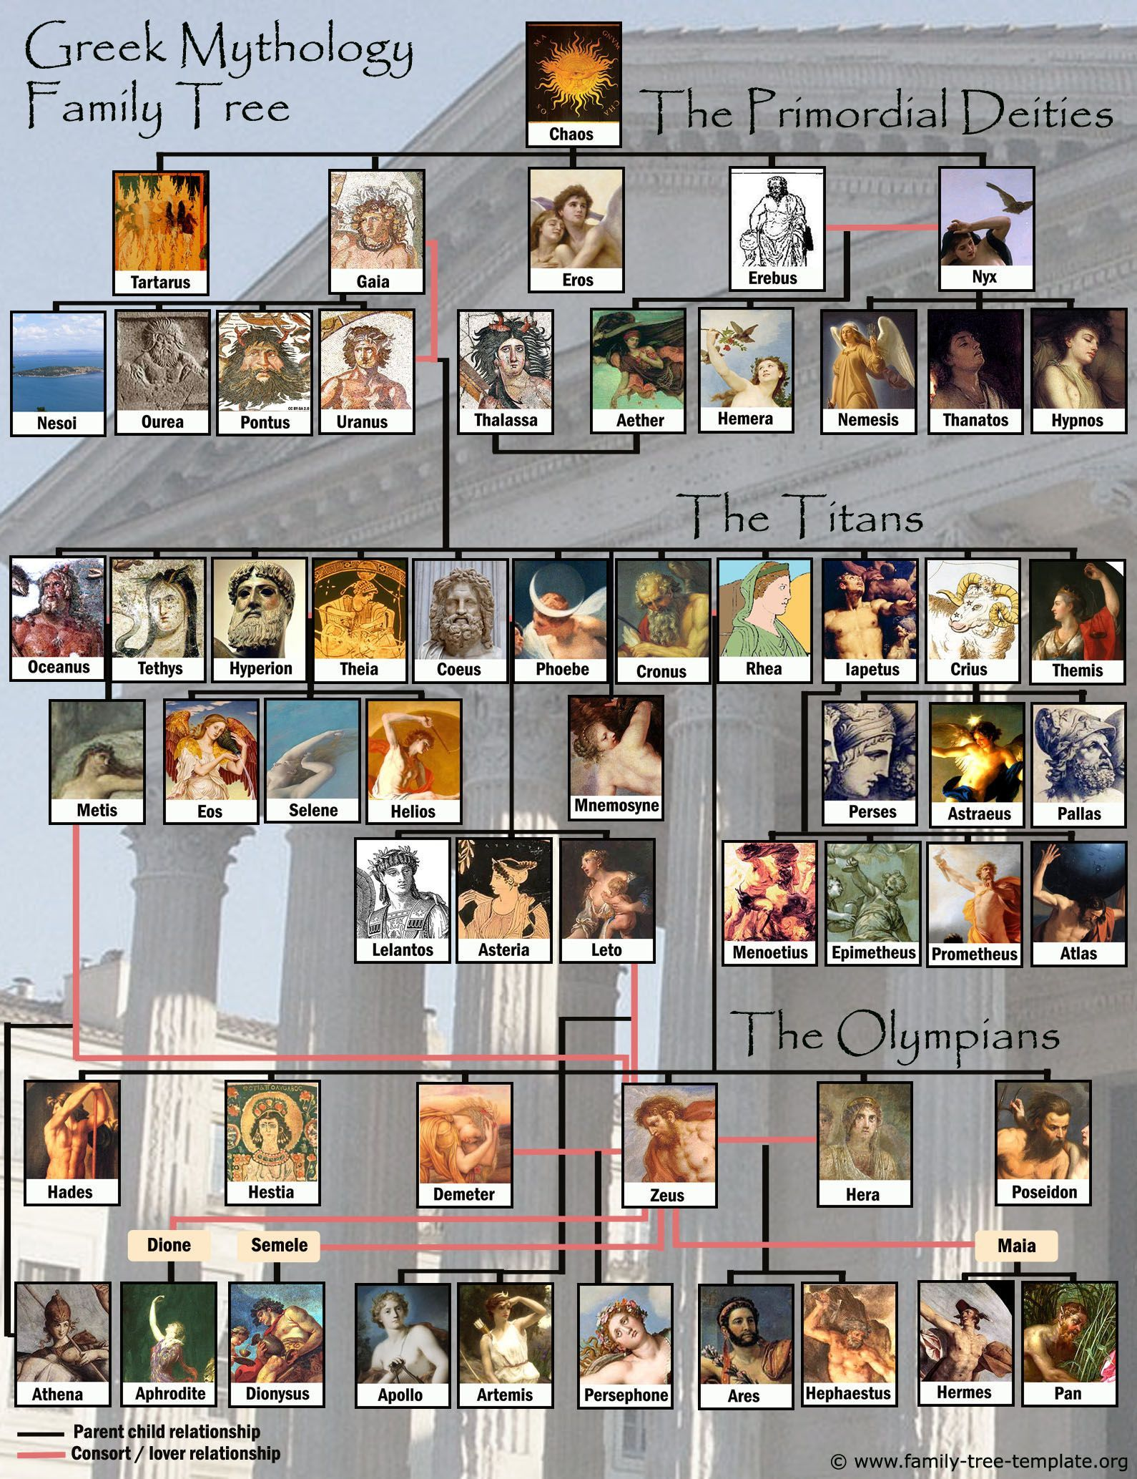
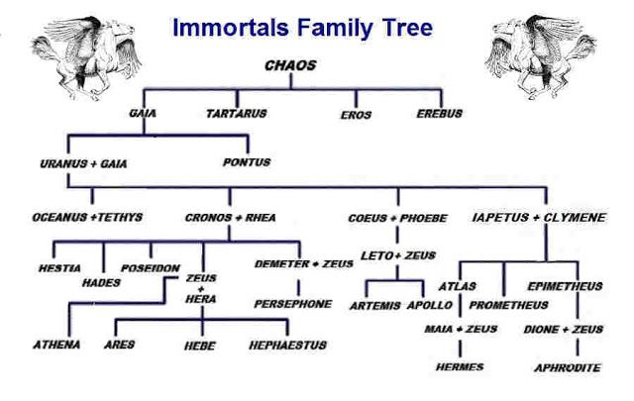
Family tree

Slide 5
Stories of Greek Mythology
Stories in Greek mythology are what make the Greek Gods, Goddesses, and demigods more memorable. Their adventures become the subject of many artists’ work, and some even influenced traditions and terminology in the modern world. There is proof of some Greek mythological characters who existed in real life, but other stories and characters are more mythological and may not seem like more than fiction stories to most people. As the reader or viewer, you are the one who decides whether these tales are legend or fact.

Slide 6
Jason and the Golden Fleece
Who Was Jason in Greek Mythology?
Jason was a character in Greek mythology who went on a quest with some of the mightiest heroes of his time, and it became one of the most famous stories in mythology. Their mission was to retrieve a golden fleece from the King Aeetes of Colchis.
Jason wasn’t always in association with a mighty group of heroes, but he was always the son of a king. His father was Aeson, king of Iolcos in Thessaly. As for Jason’s mother, no one has an exact idea who she was. She could have been Alcimede, who was the daughter of Clymene, or Tyro, the daughter of Salmoneus. Whomever Jason’s mom was, she did not have much involvement in his life.
Although Aeson was Jason’s father, he did not raise him. Jason was stillborn as a baby, so Aeson sent him to Chiron, a centaur in Greek mythology who later became the constellation Sagittarius. Chiron raised Jason until he was an adult, at which time Jason tried returning to Iolcus, where he was born. Jason was not welcome in Iolcus because of King Pelias, who usurped Aeson, Jason’s father.

Slide 7
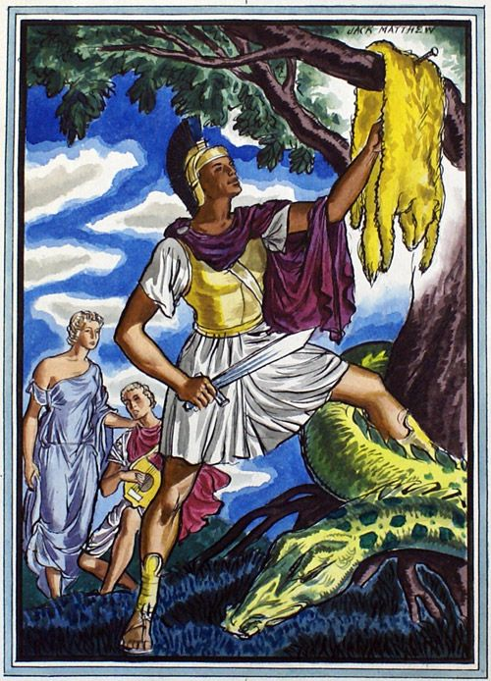
The Greek myth of Jason and the Golden Fleece is one of the oldest myths of a hero's quest. It is a classic story of betrayal and vengeance and like many Greek myths has a tragic ending. It begins when Jason's Uncle Pelias kills Jason's father, the Greek King of Iolkos, and takes his throne. Jason's mother brings him to Cheiron, a centaur (half man, half horse) who hides him away and raises him on the Mountain of Pelion.
When Jason turns 20, he journeys to see Pelias to reclaim his throne. At a nearby river, Hera the Queen of the Gods approaches him disguised as an old woman. While carrying her across the river he loses a sandal and arrives at court wearing only one. Pelias is nervous when he sees Jason missing a sandal, for an oracle has prophesied that a man wearing only one sandal shall usurp his throne.
Jason demands the return of his rightful throne. Pelias replies that Jason should first accomplish a difficult task to prove his worth. The task is for Jason to retrieve the Golden Fleece, kept beyond the edge of the known world in a land called Colchis (modern-day Georgia in Southwest Asia). The story of the fleece is an interesting tale in itself. Zeus, the King of the Gods, had given a golden ram to Jason's ancestor Phrixus. Phrixus later flew on the golden ram from Greece to Colchis, whose king was Aietes, the son of Helios the Sun God. Aietes sacrificed the ram and hung the fleece in a sacred grove guarded by a dragon, as an oracle had foretold that Aietes would lose his kingdom if he lost the fleece.

Slide 8
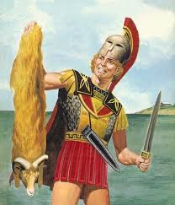
Determined to reclaim his throne, Jason agrees to retrieve the Golden Fleece. Jason assembles a team of great heroes for his crew and they sail aboard the Argo. The first stop of the Argonauts is the Greek Isle of Lemnos, populated only by women. Unknown to Jason and his crew, the women have murdered their husbands. The Argonauts fare much better though; in fact the women use the occasion as an opportunity to repopulate the island.
After many more adventures, the Argo passes Constantinople, heading for the Straits of Bosphorus. The Straits of Bosphorus are a narrow passageway of water between the Sea of Marmara, the Aegean Sea and the Black Sea. To the ancient Greeks, this was the edge of the known world. The Straits are extremely dangerous due to the currents created by the flow of water from the Black Sea. The ancient Greeks believed that clashing rocks guarded the straits and that the rocks would close together and smash any ship sailing through. Jason had been told by a blind prophet he assisted how to fool the rocks. He was to send a bird ahead of him. The rocks would crash in on it and then reopen, at which point he could successfully sail through.
When Jason finally arrives in Colchis he asks King Aietes to return the golden fleece to him as it belonged to his ancestor. Reluctant, the king suggests yet another series of challenges to Jason. He must yoke fire-breathing bulls, plough and sow a field with dragons' teeth and then overcome the warriors who will rise from the furrows. Aietes is confident the tasks are impossible but unbeknownst to the king, his daughter Medea has taken a liking to Jason. She offers to assist Jason if he will marry her. He agrees. Medea is a powerful sorceress and Jason is successful. Jason and Medea return to Greece where Jason claims his father's throne.

Slide 9
Pandora’s Box
Who was Pandora?
Pandora, (Greek: “All-Gifts”) in Greek mythology, the first woman. According to Hesiod’s Theogony, after Prometheus, a fire god and divine trickster, had stolen fire from heaven and bestowed it upon mortals, Zeus, the king of the gods, determined to counteract this blessing. He accordingly commissioned Hephaestus (a god of fire and patron of craftsmen) to fashion a woman out of earth, upon whom the gods bestowed their choicest gifts. In Hesiod’s Works and Days, Pandora had a jar containing all manner of misery and evil. Zeus sent her to Epimetheus, who forgot the warning of his brother Prometheus and made Pandora his wife. She afterward opened the jar, from which the evils flew out over the earth. Hope alone remained inside, the lid having been shut down before she could escape. In a later story the jar contained not evils but blessings, which would have been preserved for the human race had they not been lost through the opening of the jar out of curiosity. Pandora’s jar became a box in the 16th century, when the Renaissance humanist Erasmus either mistranslated the Greek or confused the vessel with the box in the story of Cupid and Psyche.

Slide 10
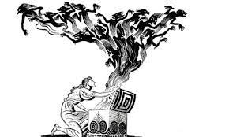
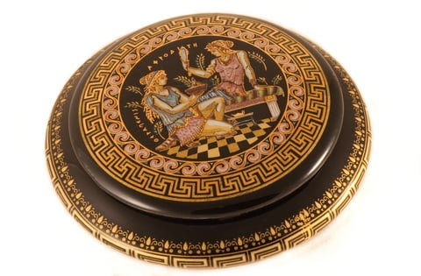
The myth of Pandora’s box is considered one of the most descriptive myths of human behavior in Greek mythology. Ancient Greeks used this myth not only to instruct themselves about the weaknesses of humans, but also to explain several misfortunes of the human race.
Pandora, The First Woman On Earth
Pandora was, according to the myth, the first woman on Earth. She was created by Gods; each one of them gave her a gift, thus, her name in Greek means “the one who bears all gifts”.
Pandora was created as a punishment to the mankind; Zeus wanted to punish people because Prometheus stole the fire to give it to them. Her gifts were beautifully evil, according to Hesiod. Hephaestus created her from clay, shaping her perfectly, Aphrodite gave her femininity and Athena taught her crafts. Hermes was ordered by Zeus to teach her to be deceitful, stubborn and curious.
Pandora was given a box or a jar, called “pithos” in Greek. Gods told her that the box contained special gifts from them but she was not allowed to open the box ever. Then Hermes took her to Epimetheus, brother of Prometheus, to be his wife. Prometheus had advised Epimetheus not to accept anything from the Gods, but he saw Pandora and was astonished by her beauty, thus he accepted her right away.

Slide 11
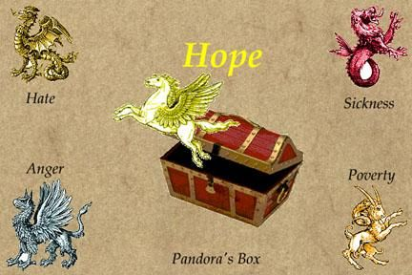
Pandora was trying to tame her curiosity, but at the end she could not hold herself anymore; she opened the box and all the illnesses and hardships that gods had hidden in the box started coming out. Pandora was scared, because she saw all the evil spirits coming out and tried to close the box as fast as possible, closing Hope inside.
According to Hesiod Hope indeed stayed inside because that was Zeus’ will; he wanted to let people suffer in order to understand that they should not disobey their gods. Pandora was the right person to do it, because she was curious enough, but not malicious.
The myth of Pandora’s box has been fascinating people since ever, catching the imagination of countless artists, who created frescos, mosaics and sculptures depicting Pandora and the mythological elements. The myth itself though appears in many different versions; the most distinctive difference is that in some myths Hope does come out. The main purpose of the myth of Pandora though is to address the question of why evil exists in the world.
The birth of Pandora was represented on the pedestal of the statue of Athena situated at the Parthenon on the Acropolis in Athens.

Slide 12
Narcissus and Echo
Who was Narcissus?
Narcissus, in Greek mythology, the son of the river god Cephissus and the nymph Liriope. He was distinguished for his beauty. According to Ovid’s Metamorphoses, Book III, Narcissus’s mother was told by the blind seer Tiresias that he would have a long life, provided he never recognized himself. However, his rejection of the love of the nymph Echo or (in an earlier version) of the young man Ameinias drew upon him the vengeance of the gods. He fell in love with his own reflection in the waters of a spring and pined away (or killed himself); the flower that bears his name sprang up where he died.
Who was Echo?
Echo, in Greek mythology, a mountain nymph, or oread. Ovid’s Metamorphoses, Book III, relates that Echo offended the goddess Hera by keeping her in conversation, thus preventing her from spying on one of Zeus’ amours. To punish Echo, Hera deprived her of speech, except for the ability to repeat the last words of another. Echo’s hopeless love for Narcissus, who fell in love with his own image, made her fade away until all that was left of her was her voice.

Slide 13

Echo was a beautiful nymph, fond of the woods and hills, where she devoted herself to woodland sports. She was a favorite of Diana, and attended her in the chase. But Echo had one failing; she was fond of talking, and whether in chat or argument, would have the last word.
One day Juno was seeking her husband, who, she had reason to fear, was amusing himself among the nymphs. Echo by her talk contrived to detain the goddess till the nymphs made their escape. When Juno discovered it, she passed sentence upon Echo in these words: “You shall forfeit the use of that tongue with which you have cheated me, except for that one purpose you are so fond of—reply. You shall still have the last word, but no power to speak first.”
This nymph saw Narcissus, a beautiful youth, as he pursued the chase upon the mountains. She loved him and followed his footsteps. O how she longed to address him in the softest accents, and win him to converse! but it was not in her power.
She waited with impatience for him to speak first, and had her answer ready. One day the youth, being separated from his companions, shouted aloud, “Who’s here?” Echo replied, “Here.” Narcissus looked around, but seeing no one, called out, “Come.” Echo answered, “Come.” As no one came, Narcissus called again, “Why do you shun me?” Echo asked the same question. “Let us join one another,” said the youth.

Slide 14
The maid answered with all her heart in the same words, and hastened to the spot, ready to throw her arms about his neck. He started back, exclaiming, “Hands off! I would rather die than you should have me!” “Have me,” said she; but it was all in vain. He left her, and she went to hide her blushes in the recesses of the woods.
From that time forth she lived in caves and among mountain cliffs. Her form faded with grief, till at last all her flesh shrank away. Her bones were changed into rocks and there was nothing left of her but her voice. With that she is still ready to reply to any one who calls her, and keeps up her old habit of having the last word.
Narcissus’s cruelty in this case was not the only instance. He shunned all the rest of the nymphs, as he had done poor Echo. One day a maiden who had in vain endeavoured to attract him uttered a prayer that he might some time or other feel what it was to love and meet no return of affection. The avenging goddess heard and granted the prayer.
There was a clear fountain, with water like silver, to which the shepherds never drove their flocks, nor the mountain goats resorted, nor any of the beasts of the forests; neither was it defaced with fallen leaves or branches, but the grass grew fresh around it, and the rocks sheltered it from the sun. Hither came one day the youth, fatigued with hunting, heated and thirsty.

Slide 15
He stooped down to drink, and saw his own image in the water; he thought it was some beautiful water-spirit living in the fountain. He stood gazing with admiration at those bright eyes, those locks curled like the locks of Bacchus or Apollo, the rounded cheeks, the ivory neck, the parted lips, and the glow of health and exercise over all. He fell in love with himself. He brought his lips near to take a kiss; he plunged his arms in to embrace the beloved object. It fled at the touch, but returned again after a moment and renewed the fascination.
He could not tear himself away; he lost all thought of food or rest, while he hovered over the brink of the fountain gazing upon his own image. He talked with the supposed spirit:
“Why, beautiful being, do you shun me? Surely my face is not one to repel you. The nymphs love me, and you yourself look not indifferent upon me. When I stretch forth my arms you do the same; and you smile upon me and answer my beckonings with the like.”
His tears fell into the water and disturbed the image. As he saw it depart, he exclaimed, “Stay, I entreat you! Let me at least gaze upon you, if I may not touch you.” With this, and much more of the same kind, he cherished the flame that consumed him, so that by degrees he lost his colour, his vigour, and the beauty which formerly had so charmed the nymph Echo.
She kept near him, however, and when he exclaimed, “Alas! alas!” she answered him with the same words. He pined away and died; and when his shade passed the Stygian river, it leaned over the boat to catch a look of itself in the waters. The nymphs mourned for him, especially the water-nymphs; and when they smote their breasts Echo smote hers also. They prepared a funeral pile and would have burned the body, but it was nowhere to be found; but in its place a flower, purple within, and surrounded with white leaves, which bears the name and preserves the memory of Narcissus.

Slide 16
Perseus and Medusa
Who was Perseus?
Perseus, one of the most famous of the legendary heroes of ancient times, was the son of Zeus and Danae, daughter of Acrisius, king of Argos. An oracle foretold to Acrisius that a son of Danae would be the cause of his death, so he imprisoned her in a tall tower in order to keep her isolated from the world. Zeus, however, descended through the roof of the tower in the form of a shower of gold, and the lovely Danae became his bride. For four years Acrisius had no idea this happened, but one evening as he happened to walk by Danae’s room, he heard the cry of a young child from within, which led to the discovery of his daughter’s marriage with Zeus. Enraged, Acrisius commanded the mother and child to be placed in a chest and thrown into the sea. But it was not the will of Zeus that they should die. The chest floated safely to the island of Seriphus, where Dictys, brother of Polydectes, king of the island, was fishing on the seashore and saw the chest abandoned on the beach. Pitying the helpless condition of its unhappy occupants, he led them to the palace of the king. Polydectes knew he wanted Danae as his wife the instant he laid eyes on her. Yet for many years Danae and Perseus remained on the island, where, unbeknownst to Polydectes, Perseus received an education suitable for a hero from the best teacher available–Achilles’, Hercules’, Jason’s, and Theseus’ teacher, Chiron the Centaur.
Who was Medusa?
Medusa, in Greek mythology, the most famous of the monster figures known as Gorgons. She was usually represented as a winged female creature having a head of hair consisting of snakes; unlike the Gorgons, she was sometimes represented as very beautiful. Medusa was the only Gorgon who was mortal; hence her slayer, Perseus, was able to kill her by cutting off her head. From the blood that spurted from her neck sprang Chrysaor and Pegasus, her two sons by Poseidon. The severed head, which had the power of turning into stone all who looked upon it, was given to Athena, who placed it in her shield; according to another account, Perseus buried it in the marketplace of Argos.

Slide 17
As he grew up, Perseus believed Polydectes was less than honorable, and protected his mother from him; then Polydectes plotted to send Perseus away on a long, impossible task to humiliate him, or even better, kill him so that he would stop interfering with his plan to marry Danae. He held a large banquet where each guest was expected to bring a gift, but Perseus was unaware of this custom, so he asked Polydectes to name the gift; he would not refuse it. Polydectes held Perseus to his reckless promise and demanded the head of the only mortal Gorgon, Medusa, whose gaze turned people to stone.
To accomplish this, Athena, the patron of heroes, advised him to find the Hesperide Nymphs, whom only the Grææ knew where they lived. Perseus started on his expedition, and, guided by Hermes and Athena, arrived, after a long journey, in the far-off region, on the borders of Oceanus, where the Grææ lived. The Grææ were three very old, gray-haired women, sisters of the Gorgons, who shared one eye and tooth. He at once asked them for the necessary information, and on their refusing to grant it he stole their single eye, which he only gave back to them when they gave him full directions with regard to his route. He then proceeded to the land of the Hesperides, from whom he may obtain the objects crucial to his purpose.
From the Hesperides he received a bag to safely contain Medusa’s head. Zeus gave him an adamantine sword and Hades’ helm of darkness to make him invisible. Hermes lent Perseus winged sandals to fly, and Athena gave him a polished shield. Perseus then proceeded to the Gorgons’ cave.
Equipped with the magic items, he attached to his feet the winged sandals and flew to the land of the Gorgons, whom he found fast asleep in a cave. Now as Perseus had been warned by his heavenly guides that whoever looked upon these weird sisters would be transformed into stone, he stood with his face turned away from the sleepers, and looked at them through the reflection in his bright metal shield. Then, guided by Athena, he cut off the head of the Medusa, which he placed in his bag. As soon as had he done that, from Medusa’s headless body there sprang forth the winged horse Pegasus, who flew up into the sky. He now hurried to escape the pursuit of the two surviving sisters, who, awoken from their sleep, eagerly rushed to avenge the death of their sister.

Slide 18
His invisible helmet and winged sandals here came in handy; for the former concealed him from the view of the Gorgons, while the latter carried him swiftly over land and sea, far beyond the reach of pursuit. In passing over the burning plains of Libya the drops of blood from the head of the Medusa oozed through the bag and falling on the hot sands below produced many-colored snakes, which spread all over the country. Droplets of blood that landed in the Red Sea created coral reefs underwater.
Perseus continued his flight until he reached the kingdom of Atlas, of whom he begged rest and shelter. But as Atlas protected the Garden of the Hesperides, where every tree produced golden fruit, he was afraid that this hero who just killed the monstrous Medusa might also destroy the dragon which guarded it and then steal his treasures. He therefore refused to grant the hospitality which the hero demanded. So, Perseus, irritated at Atlas’ refusal, reached into his bag and pulled out the head of the Medusa, and holding it towards the king, transforming him into a stony mountain. Beard and hair erected themselves into forests; shoulders, hands, and limbs became huge rocks, and the head grew up into a rocky peak which reached into the clouds.
Perseus then resumed his travels. His winged sandals carried him over deserts and mountains, until he arrived at Ethiopia, the kingdom of King Cepheus. Here he found the country filled with disastrous floods, towns and villages destroyed, and everywhere signs of devastation and ruin. On a projecting cliff close to the shore, he noticed a lovely maiden chained to a rock. This was Andromeda, the king’s daughter. Her mother Cassiopeia, having boasted that her beauty surpassed that of the Nereides, caused the angry sea-nymphs to appeal to Poseidon to retaliate, and thus the sea-god devastated the country with terrible waves, which brought with it a huge monster who consumed all that came in his way.

Slide 19
In their distress, the unfortunate Ethiopians begged the oracle of Zeus, Ammon, in the Libyan desert, and received the response that only by the sacrifice of the king’s daughter to the monster could the country and people be saved.
Cepheus, who fondly loved his dear daughter Andromeda, at first refused to listen to this dreadful proposal; but overcome at length by the prayers and begging of his unhappy citizens, the heartbroken father gave up his child for the welfare of his country. Andromeda was then chained to a rock on the seashore to serve as a prey to the monster, while her unhappy parents watched her sad fate on the beach below.
On being informed of the meaning of this tragic scene, Perseus proposed to Cepheus to kill the monster, on condition that the lovely victim should become his bride. Overjoyed at the possibility of Andromeda’s release, the king gladly accepted, and Perseus raced to the rock, to breathe words of hope and comfort to the frightened girl. Then putting on once more the helmet of Hades, he jumped into the air and waited for the approach of the monster.
The sea opened, and the shark’s head of the gigantic beast raised itself above the waves. Lashing his tail furiously from side to side, he leaped forward to bite his victim; but the courageous hero, watching his opportunity, suddenly darted down, and bringing out the head of the Medusa from his bag held it before the eyes of the dragon, whose hideous body became gradually transformed into a huge black rock. Perseus then unchained Andromeda and led her to her now happy parents, who, anxious to show their gratitude, ordered immediate preparations to be made for the marriage feast.

Slide 20
Perseus then left the Ethiopian king, and, accompanied by his beautiful bride, returned to Seriphus, where Perseus returned to give King Polydectes the “gift” he requested. When he did not find his mother in his court, and Polydectes would not reveal where she was, Perseus pulled out Medusa’s head from the bag. Polydectes revealed that he locked her in a dungeon, just before his mouth and whole head turned to stone.
After he rescued his mother, he then sent a messenger to his grandfather, informing him that he intended to return to Argos; but Acrisius, fearing the fulfillment of the oracle’s prophecy, fled for protection to his friend Teutemias, king of Larissa. Anxious to return to Argos, Perseus followed him. But here a strange accident occurred. While taking part in some funeral games, celebrated in honor of the king’s father, Perseus, by an unfortunate throw of the discus, accidentally struck his grandfather, and thereby was the innocent cause of his death.
After celebrating the funeral rites of Acrisius, Perseus presented the head of the Medusa to his divine protector Athena, who placed it in the center of her shield. Later on, as happens to demi-gods, when Perseus’ mortal half died, he was taken up to the heavens and became a constellation, and afterwards Andromeda was also taken to the sky to shine near his stars, along with her mother, Cassiopeia.

Slide 21
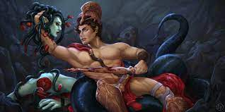
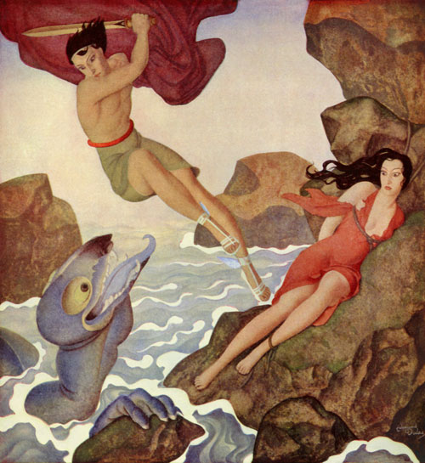

Slide 22
THE BIRTH OF THE TWINS APOLLO AND ARTEMIS
Apollo and Artemis were two twins, born of Zeus, king of the gods, and Leto, a daughter of Titans s Coeus and Phoebe.
Leto was a very kind and loving deity but was hated by Hera, Zeus' wife, for seducing her husband. So when Leto got pregnant and Hera found out, she specifically forbade any place under the sun to harbor the sinful woman. She even held her daughter Eileithyia, the goddess of childbirth, tightly in her arms to prevent her from assisting Leto in her labor.
Zeus took pity on Leto and transformed her into a quail (ortyx) to bear her children. However, there seemed to be no place in all of Greece willing to provide shelter for Leto, so she wandered desperately and aimlessly...
Eventually, Leto discovered a tiny Cycladic island near Mykonos called "Asteria" (or Ortygia, derived from Leto's transformation into a quail).
This island was battered by the waves and blown by the wind and did not even have a fixed position in the sea, yet it was ready to receive the woman. When Leto settled on the island, the island became solid and its name was changed to "Delos" - "the unconcealed one".

Slide 23
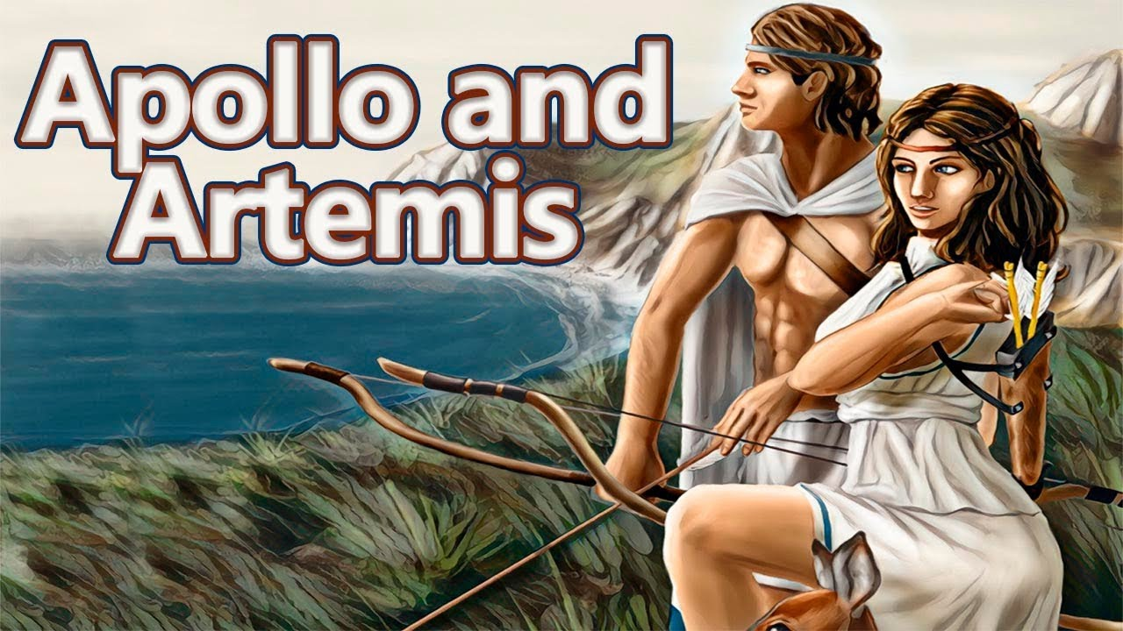
For nine days and nine nights, Leto suffered intense pain, until on the tenth day she went near a small lake, leaned against a palm tree, loosened her belt, and gave birth to Artemis, the Greek goddess of the hunt.
Artemis then acted as a midwife for her mother to give birth to her brother Apollo. For this reason, she was declared the new goddess of childbirth, taking the place of Hera's daughter Eilithyia.

Slide 24
Oedipus – The Myth
The son of Laius and Jocasta, King and Queen of Thebes, Oedipus is the unfortunate main protagonist of “one of the best-known of all legends” in Ancient Greek – or any other – mythology. Left, while still a baby, to die in the mountains by his father – who had been warned that his son would kill him and marry his wife – Oedipus was eventually adopted by the childless King Polybus and Queen Merope of Corinth. After accidentally finding about the gruesome prophecy himself, in fear and disgust the young Oedipus fled Corinth and – guided by cruel destiny – wound up crossing paths with his real father at a narrow crossroad; after a brief argument with Laius’ charioteer over who had the right to go first, Oedipus killed both of them. Wandering aimlessly, he subsequently reached the city of Thebes where he encountered the monstrous gate-guarding Sphinx; after he answered her riddle, the Sphinx went mad and hurled herself to her death. As a reward for rescuing the city from this vicious beast, Oedipus was afterward offered the vacant throne of Thebes and the hand in marriage of the ex-king’s widow, his very own mother. Jocasta bore her son four children – Polynices, Eteocles, Antigone, and Ismene – before a belated investigation into the death of Laius led Oedipus into discovering the dreadful truth of his marriage. Upon realization, Jocasta hanged herself, and Oedipus gouged his eyes with two pins snatched from her regal dress.

Slide 25
Oedipus, the Abandoned Prince Oedipus' Biological Parents: Laius and Jocasta
As it often happens in Greek mythology – and, who knows, maybe in life as well – the story of Oedipus starts sometime before his own birth. Laius, the childless King of Thebes, decided to consult the Oracle at Delphi to learn if he and his wife would ever have any children. To his utter dismay, he was told that it would be better for him that they don’t: any son born out of their union was destined to kill him. Laius tried staying away from his wife’s bed as much as he could, but all his effort was undone by a night of revels and sweet-tasting wine. Jocasta got pregnant and, in due time, gave birth to a baby boy. To thwart the prophecy, Laius told his servants to pierce the baby's ankles, so that it would not be able to even crawl, let alone cause him some harm; afterward, so as to be even safer, he gave his son to one of Thebes’ shepherds, telling him to leave the baby in the mountains to die. The shepherd, unable to do such a thing, handed the baby over to a second shepherd, who happened to pasture his flocks on the same mountain.

Slide 26
Oedipus' Adoptive Parents: Polybus and Merope
A Corinthian, this second shepherd took pity on the boy and brought it at the court of King Polybus and Queen Merope of Corinth. The royal couple, also childless, decided to adopt the poor baby and raise him as their own. They named the boy after his ankle wounds: Oedipus means “Swollen Foot.” When Oedipus grew up, he was told by a drunkard that Polybus and Merope were not his birth parents. Deciding to investigate this matter, Oedipus ended up in Delphi, with an intention to learn the truth from the Oracle. Instead of getting the answer he had come from, Oedipus was told that he would kill his father and marry his mother. Upon hearing this, Oedipus decided instantaneously to leave Corinth and go as far from it as possible; so, he headed northward, in the fated direction of his birth town, Thebes.
Killing Laius
On his way there, at a narrow three-way intersection near Daulis, he came across a chariot carrying King Laius, his biological father. Oedipus and Laius' charioteer started quarreling over who had the right of way. The quarrel ended up with Oedipus killing both the charioteer and his father, thus unknowingly fulfilling the first half of his prophecy. Only one of Laius’ servants managed to save his life from the wrath of Oedipus.

Slide 27
The Riddle of the Sphinx
Soon after, Oedipus hit upon the terrible Sphinx, who had plagued the region of Thebes for some time then, destroying crops and devouring travelers who had either refused to answer her riddle or answered it wrongly. The Sphinx asked Oedipus the same question she had asked the unfortunate ones before him: “What walks on four feet in the morning, two in the afternoon, and three at night?” No one had ever answered the question correctly before. But Oedipus thought carefully and eventually solved the riddle: “Man – who crawls on all fours as a baby, then on two legs as an adult, and then with a walking stick when in old age.” The Sphinx, unable to bear the fact that her riddle had been answered correctly, hurled herself off the rock she was sitting on and to her death.
Oedipus the King: King of Thebes
At the time, Thebes had an interim ruler, Creon, the brother of the widowed Jocasta and Oedipus’ uncle. Even before Oedipus’ arrival, Creon had decreed that anyone who would manage to kill the Sphinx would be rewarded the hand of the queen and the throne of Thebes. Consequently – unbeknownst to him or, for that matter, anyone else – Oedipus’ reward for rescuing Thebes from the Sphinx would end up being a most bitter one: his father’s crown and marriage to his mother. Neither recognizing the other, Oedipus and Jocasta begot four children together: Eteocles, Polynices, Antigone, and Ismene.

Slide 28
The Plague
Years later, Thebes is hit with a terrible plague. Oedipus, determined to cure his city, does everything in his power to get to the bottom of the matter; and after Creon returns from a consultation with the Oracle at Delphi with the news that the plague is divine retribution for the killer of Laius never being taken to justice, Oedipus gives a solemn oath to find him and punish him severely – of course, not having even the slightest idea that the killer is, in fact, him. Oedipus questions the prophet Tiresias who, though blind, is able to see more and more profoundly than his questioner. At one point, forced to tell everything he knows, Tiresias points the finger of blame in the direction of the Theban king. However, Oedipus refuses to believe that he could have anything to do with Laius’ murder and instead blames Tiresias for plotting with Creon to depose him.
The Truth
Jocasta tries comforting Oedipus and, in the process, informs him about the events which led to the death of her husband. They sound strikingly similar to his chance encounter with the unknown charioteer at Daulis, and, visibly shaken, Oedipus sends for that one Laius’ servant who managed to survive the scene. However, things go from bad to worse, even before the servant is brought to him: a messenger from Corinth enters the court and informs everyone that Polybus had died. Still believing that Polybus is his real father, Oedipus is somewhat relieved to hear this; however, fearing that the second part of the prophecy may still materialize, he declines to attend the funeral in order to avoid meeting his mother. The messenger informs Oedipus that he doesn’t need to worry about that, for he knows full well that Polybus and Merope aren’t his real parents: it just so happens that he is the very shepherd who handed them the ankle-pierced Oedipus when he was still a baby!

Slide 29
Self-blinding
Jocasta needs no further evidence than this: she flees the scene in utter distress and hangs herself in her chamber. Still unconvinced, Oedipus waits for the single eyewitness of the murder of Laius only to realize that the worst is true: he had, in fact, killed his father years ago and married his mother afterward. Oedipus tries to find Jocasta, and after locating her lifeless body, tears out two golden pins from her gown and pricks his eyes. As he had promised to do with the killer of Laius, he banishes himself from the city; guided by his daughter and sister Antigone, Oedipus reaches the court of King Theseus of Athens, where both are warmly welcomed. Years afterward, after cursing his disobedient sons, the blind and weary-of-life Oedipus is mysteriously taken by the gods at a spot known only to his host Theseus.
The Aftermath
After Oedipus' death, his sons Polynices and Eteocles decide to share the throne of Thebes, but when Eteocles refuses to give the throne once his time is over, Polynices leaves Thebes and returns with an army. The attack of the Seven Against Thebes results in both brothers dying on the battlefield; the conditions of their burial becomes a cause for the famous conflict between Antigone and once-again Theban king, Creon.

Slide 30
JUDAIC CHRISTIAN MYTHS

Slide 31
Genesis in The Bible
Genesis, Hebrew Bereshit (“In the Beginning”), the first book of the Bible. Its name derives from the opening words: “In the beginning….” Genesis narrates the primeval history of the world (chapters 1–11) and the patriarchal history of the Israelite people (chapters 12–50). The primeval history includes the familiar stories of the Creation, the Garden of Eden, Cain and Abel, Noah and the Flood, and the Tower of Babel.
God creates the world in six days and consecrates the seventh as a day of rest (which would then be known as Sabbath in Jewish culture). God creates the first humans, Adam and Eve, and all the animals in the Garden of Eden but instructs them not to eat the fruit of the tree of knowledge of good and evil. They promise not to, but a talking serpent, portrayed as a deceptive creature or trickster, convinces Eve into eating it against God's wishes, and she convinces Adam, whereupon God throws them out and curses both of them — Adam was cursed with getting what he needs only by sweat and work, and Eve to giving birth in pain.

Slide 32
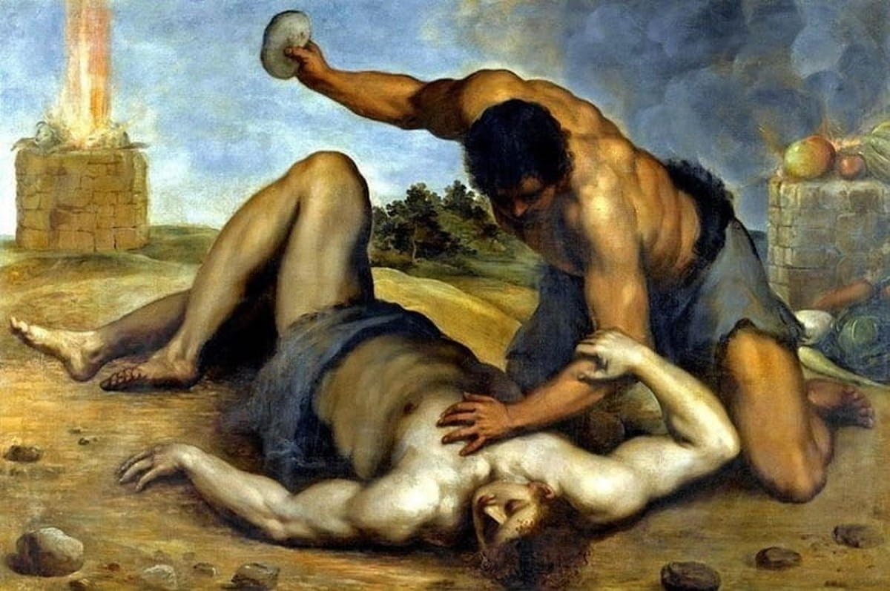
Cain and Abel
In the biblical Book of Genesis, Cain and Abel are the first two sons of Adam and Eve. Cain, the firstborn, was a farmer, and his brother Abel was a shepherd.
The brothers made sacrifices to God, each of his own produce, but God favoured Abel's sacrifice instead of Cain’s.
Cain then murdered Abel, whereupon God punished Cain by condemning him to a life of wandering.
Cain then dwelt in the land of Nod ('wandering'), where he built a city and fathered the line of descendants beginning with Enoch.

Slide 33
The Story as in Book of Genesis:
And the human knew Eve his woman and she conceived and bore Cain, and she said, "I have got me a man with the Lord.“
And she bore as well his brother Abel, and Abel became a herder of sheep while Cain was a tiller of the soil. And it happened in the course of time that Cain brought from the fruit of the soil an offering to the Lord. And Abel too had brought from the choice firstlings of his flock, and the Lord regarded Abel and his offering but did not regard Cain and his offering. And Cain was very incensed, and his face fell.
And the Lord said to Cain,
"Why are you incensed,
and why is your face fallen?
For whether you offer well,
or whether you do not,
at the tent flap sin crouches
and for you is its longing,
but you will rule over it."

Slide 34
And Cain said to Abel his brother, "Let us go out to the field," and when they were in the field Cain rose against Abel his brother and killed him. [iv] And the Lord said to Cain, "Where is Abel your brother? And he said, "I do not know: am I my brother's keeper?" [v] And He said, "What have you done? Listen! your brother's blood cries out to me from the soil. And so, cursed shall you be by the soil that gaped with its mouth to take your brother's blood from your hand. If you till the soil, it will no longer give you strength. A restless wanderer shall you be on the earth." And Cain said to the Lord, "My punishment is too great to bear. Now that You have driven me this day from the soil I must hide from Your presence, I shall be a restless wanderer on the earth and whoever finds me will kill me." And the Lord said to him, "Therefore whoever kills Cain shall suffer sevenfold vengeance." And the Lord set a mark upon Cain so that whoever found him would not slay him.
And Cain went out from the Lord's presence and dwelled in the land of Nod east of Eden. And Cain knew his wife and she conceived and bore Enoch. Then he became the builder of a city and he called the name of the city like his son's name, Enoch.

Slide 35
David and Goliath
The David and Goliath Bible story relates to a key Christian teaching from the book of Samuel in the Old Testament. Because it was written before Jesus was born, this book is also known as the Hebrew Bible.
It tells the story of two tribes of people, known as the Israelites and the Philistines. Due to being enemies, they planned a large battle against each other and assembled armies.
The Philistines had an enormous army, including a giant called Goliath. It is thought that he was 9 feet tall! He wore a huge helmet and armour all over his body. It was made of bronze and weighed 125 pounds. That’s heavier than a small child! On his legs, Goliath also wore bronze greaves and had a sharp javelin on his back. He was holding a sharp spear shaft too with an iron point. All in all, he was fit for battle and a terrifying threat to the Israelites.
On the battlefield, Goliath said, Why do you come out and line up for battle? Choose a man and have him come down to me. If he is able to fight and kill me, we will become your subjects; but if I overcome him and kill him, you will become our subjects and serve us. Give me a man and let us fight each other.”
For 40 days, Goliath went towards the Israelites to ask for a battle.
A small shepherd boy heard this and decided he would be the one to fight Goliath. His name was David and he was one of the Israelites. He asked his leader, King Saul about this. Saul agreed that David would be the one to fight Goliath, and said: “Go, and the Lord be with you”.

Slide 36
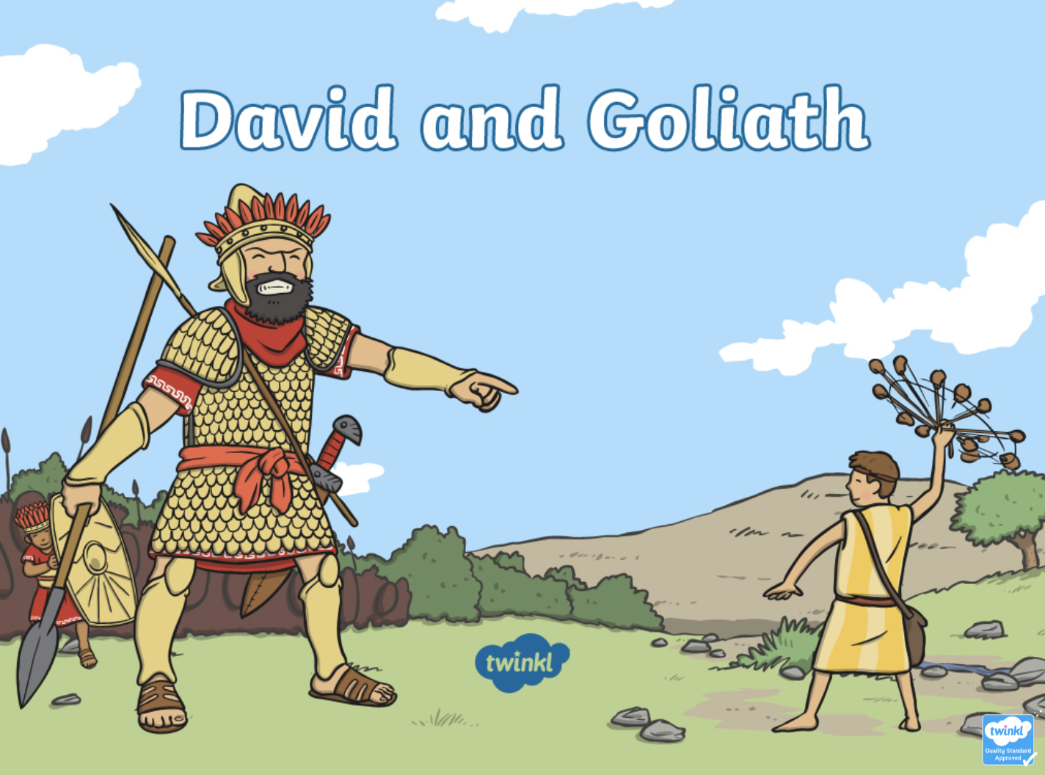
King Saul dressed David in his very own tunic. Armour was put on his body for protection and a large helmet was put on his head. But David the shepherd boy was not used to this. “I cannot go in these, because I am not used to them,” said David and he removed the heavy armour.
He then walked towards a nearby stream and put five smooth stones into the pouch of his shepherd’s bag. He then walked towards Goliath, the Philistine. When seeing David approach him, Goliath said, “Am I a dog, that you come at me with sticks? Come here and I’ll give your flesh to the birds and the wild animals!”.
David replied, “you come against me with sword and spear and javelin, but I have the Lord on my side!” And all at once, he put one of the five stones into the sling, swung it around his head, and let the stone go. It hit Goliath’s skull and he fell face-down to the ground. Not even with a sword or armour, David had killed Goliath and saved the Israelites from becoming slaves to the Philistines.
https://www.churchofjesuschrist.org/study/manual/old-testament-stories/chapter-28-david-and-goliath?lang=eng

Slide 37
Noah’s Ark
he Lord saw how utterly wicked people on earth had become; every thought was only evil all the time. So God said, “I will destroy from the earth the people I have created. And with them, the animals, birds, and creeping things” (Genesis 6:5–7).
But Noah found favor with God for he alone was righteous among the people of his day. Noah had three sons: Shem, Ham, and Japheth. And God said to him, “I will establish My covenant with you; you will go into the ark with your wife, your sons, and their wives” (Genesis 6:8–10, 18).
God said to Noah, “I am going to destroy all flesh because the world is full of violence. Build an ark of gopherwood, with rooms inside, three decks, and a door. Cover it inside and out with pitch.” And Noah did exactly as God commanded him (Genesis 6:13–22).
God also told Noah, “Take with you seven pairs of all clean animals, the male and his mate, and a pair of the animals that are not clean, the male and his mate, and seven pairs of the birds of the heavens also, male and female, to keep their offspring alive on the face of all the earth” (Genesis 7:2–3, ESV).
https://www.churchofjesuschrist.org/study/manual/old-testament-stories/chapter-6-noah?lang=eng

Slide 38
So Noah and his family went into the Ark because of the coming Flood. And every land animal after its kind went with them, two by two, male and female, just as God had commanded. And the Lord shut the door (Genesis 7:7–16).
Then the Flood began. The fountains of the deep broke open, and the windows of heaven were opened. Rain poured for forty days and forty nights. The waters rose until every high hill on the earth was covered. Everything that lived on land perished in the raging floodwaters (Genesis 7:17–24).
The waters flooded the earth for one hundred and fifty days. And God remembered Noah and the animals on the Ark. The waters receded and the Ark came to rest on the mountains of Ararat (Genesis 8:1–5).
After sending out a raven, Noah sent out a dove to see if there was dry ground. But it came back having found nowhere to perch. After seven days, Noah sent it back out and it came back with a fresh olive leaf in its mouth. And Noah knew the ground was drying (Genesis 8:6–12).
Then God told Noah, “Come out of the ark. And bring the animals with you so they can be fruitful and multiply and fill the earth.” So Noah and his family came out with all the animals (Genesis 8:13–19).
Then Noah built an altar and offered burnt offerings to the Lord on it. And God said, “Never again will I curse the ground because of man or send a flood to destroy all living things, even though mankind’s heart is evil from childhood.” And God blessed Noah and his family saying, “Be fruitful and increase in number and fill the earth” (Genesis 8:20–22). https://arkencounter.com/noahs-ark/story/

Slide 39
The Magi
The Bible story of the Three Wise Men, from the gospel of Matthew, is also known as the biblical Magi or the Three Kings. This Bible story regards a group of scholarly foreigners who traveled to visit Jesus after his birth, bearing gifts of gold, frankincense, and myrrh.
After Jesus was born in Bethlehem of Judea, during the time of King Herod, Wise Men from the east came to Jerusalem and asked, 'Where is the one who has been born king of the Jews? We saw his star in the east and have come to worship him.' When King Herod learned this he was troubled, and all of Jerusalem with him. He called together all the leading clerics and scholars of the law, he questioned them where the Christ was to be born. 'In Bethlehem in Judea,' they answered, 'for this is what the prophet has written: "'But you, Bethlehem, in the land of Judah, are by no means least among the rulers of Judah; for out of you will come a ruler who will be the shepherd of my people Israel.'" Then Herod summoned the Wise Men secretly and found out from them the precise time the star had emerged. He sent them to Bethlehem and said, 'Go and make a careful search for the child. As soon as you find him, report to me, so that I too may go and worship him.'
As directed by King Herod, they went on their way, and the star they had seen in the East went before them until it stopped over the area where the child laid. Upon arriving at the house, they observed the child with his mother Mary, and they kneeled down and worshiped him. Then they opened their treasures and presented him with gifts of gold, incense, and myrrh. They were then miraculously warned in a dream not to go back to Herod, as he planned to kill Jesus in preserving his authority, and returned to their home by an alternative route.
https://www.biblestudytools.com/bible-stories/three-wise-men.html

Slide 40
The Pomegranate Seeds
https://www.ibiblio.org/eldritch/nh/tt06.html
https://docs.google.com/document/d/1g81bytesT6DwXysnkXEGZ_gJJn87nhypU8EGAaEXABg/edit

Slide 41
The Fifth Labour
http://www.talesbeyondbelief.com/myth-stories/fifth-labor-of-hercules.htm
https://www.greek-gods.info/greek-heroes/heracles/labors/the-stables-of-augeas/
http://www.perseus.tufts.edu/Herakles/stables.html

Slide 42
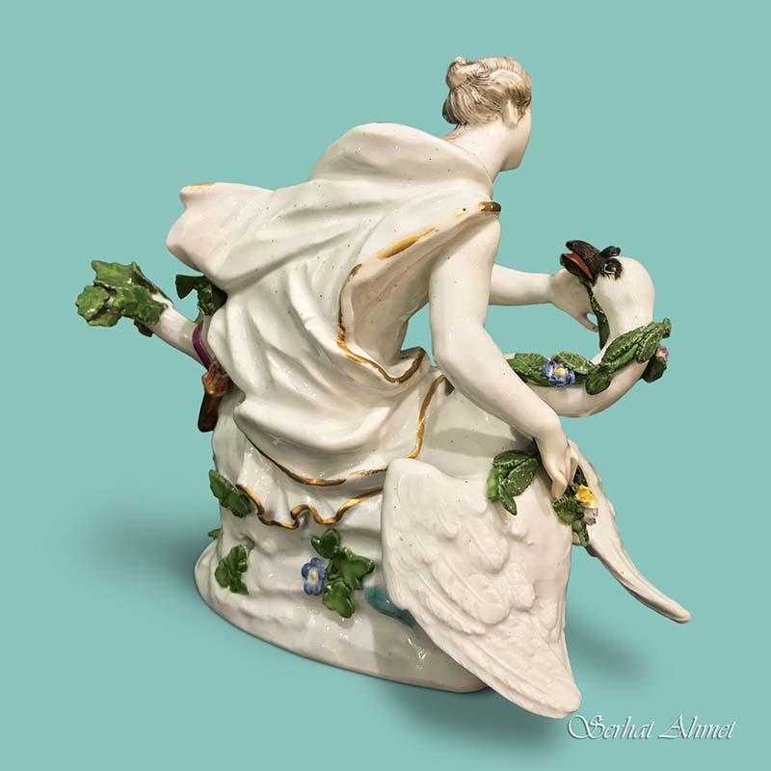
Leda and the Swan by Yeats
A sudden blow: the great wings beating still
Above the staggering girl, her thighs caressed
By the dark webs, her nape caught in his bill,
He holds her helpless breast upon his breast.
How can those terrified vague fingers push
The feathered glory from her loosening thighs?
And how can body, laid in that white rush,
But feel the strange heart beating where it lies?
A shudder in the loins engenders there
The broken wall, the burning roof and tower
And Agamemnon dead.
Being so caught up,
So mastered by the brute blood of the air,
Did she put on his knowledge with his power
Before the indifferent beak could let her drop?

