Slide 1


Cyber Security
Protecting Our Digital World
Presented By: Aman Kumar ( Asst. Professor,BCA/PGDCA, Khagarijan College)

Slide 2

What is Cyber Security?
Cyber security refers to the body of technologies, processes and practices designed to protect networks, devices, programs and data from attack, damage or unauthorized access.
It encompasses the CIA triad: Confidentiality, Integrity, and Availability.
Confidentiality
Integrity
Ensuring that data is accessed only by authorized individuals.
Maintaining the accuracy and consistency of data over its lifecycle.
Availability
Risk Management
Ensuring that information and resources are accessible when needed.
Identifying, assessing and controlling threats to organizational assets.

Slide 3

Common Cyber Threats
Phishing
Fraudulent attempts to obtain sensitive information by disguising as a trustworthy entity in electronic communication.
Malware
Software intentionally designed to cause disruption to a computer, server, client, or computer network, or to steal data.
Ransomware
A type of malware that threatens to publish the victim's data or perpetually block access to it unless a ransom is paid.
Social Engineering
Psychological manipulation of people into performing actions or divulging confidential information.

Slide 4
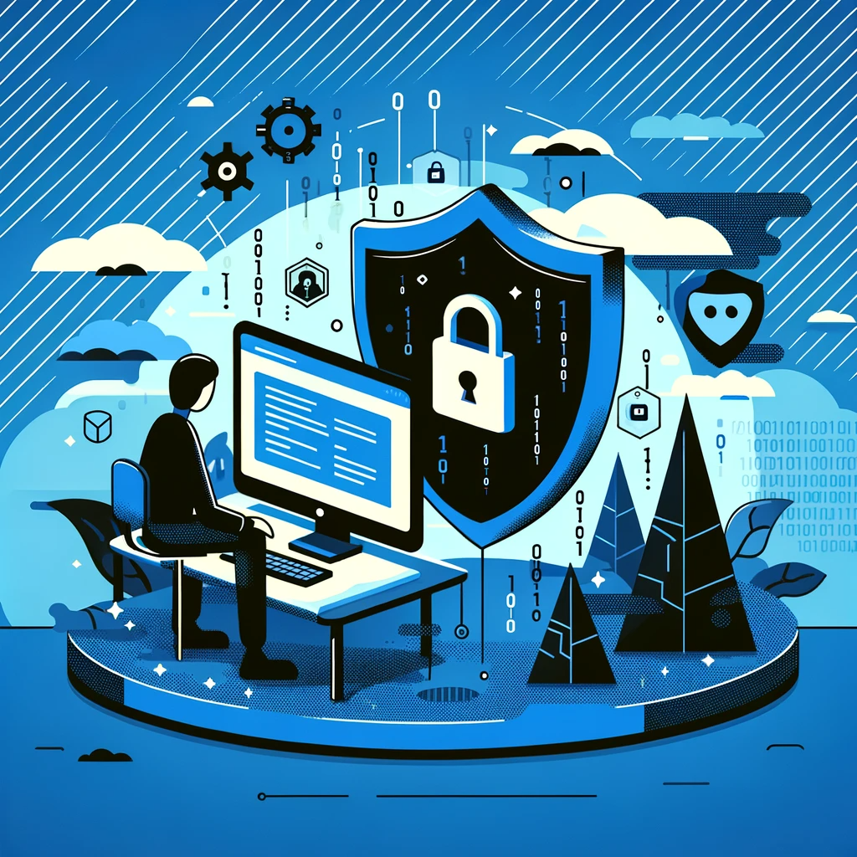
Best Practices for Cyber Security
Strong Passwords
Use complex passwords with a mix of letters, numbers, and symbols. Avoid using the same password across multiple accounts. Consider using a password manager.
Multi-Factor Authentication (MFA)
Enable MFA wherever possible to add an extra layer of security. This requires not only a password but also a second factor like a text message code or authentication app.
Regular Updates
Keep your operating system, software, and applications up-to-date. Updates often include patches for security vulnerabilities that could be exploited by attackers.
Cautious Link Clicking
Be wary of unsolicited emails or messages containing links. Verify the source before clicking to avoid phishing traps and malware downloads.

Slide 5
How to Respond to Cyber Attacks
01
02
Disconnect Immediately
Report the Incident
Isolate the affected device from the network to prevent the spread of malware or unauthorized access to other systems.
Notify your IT department, security team or relevant authorities immediately. Prompt reporting can limit damage and aid in investigation.
03
04
Change Passwords
Monitor and Review
Reset credentials for all potentially compromised accounts, starting with critical systems. Use strong, unique passwords for new credentials.
Closely monitor systems for unusual activity post-incident. Review security logs to understand the attack vector and prevent recurrence.

Slide 6
Key Takeaways
👁️
📚
🔒
Stay Vigilant
Stay Informed
Stay Secure
Always be cautious of unsolicited communications and suspicious links. Monitor your accounts regularly for unauthorized activity.
Keep up-to-date with the latest threats and security practices. Knowledge is your first line of defense against cyber attacks.
Implement strong passwords, enable multi-factor authentication, and maintain updated security software on all devices.
Security is not a product, but a process.

Slide 7
Thank You

